Slide 1
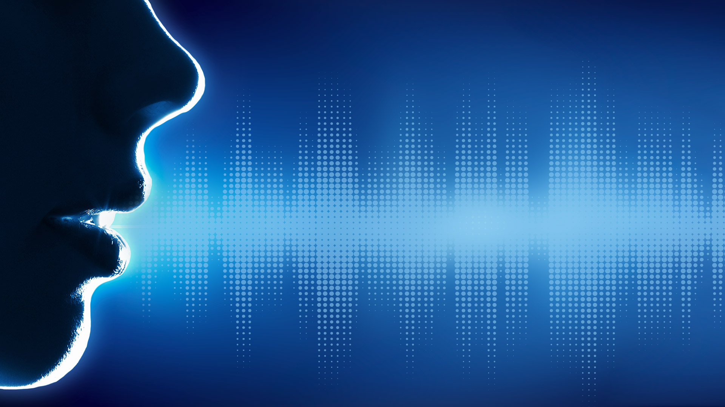
The X-Factor of Authentication

Slide 2

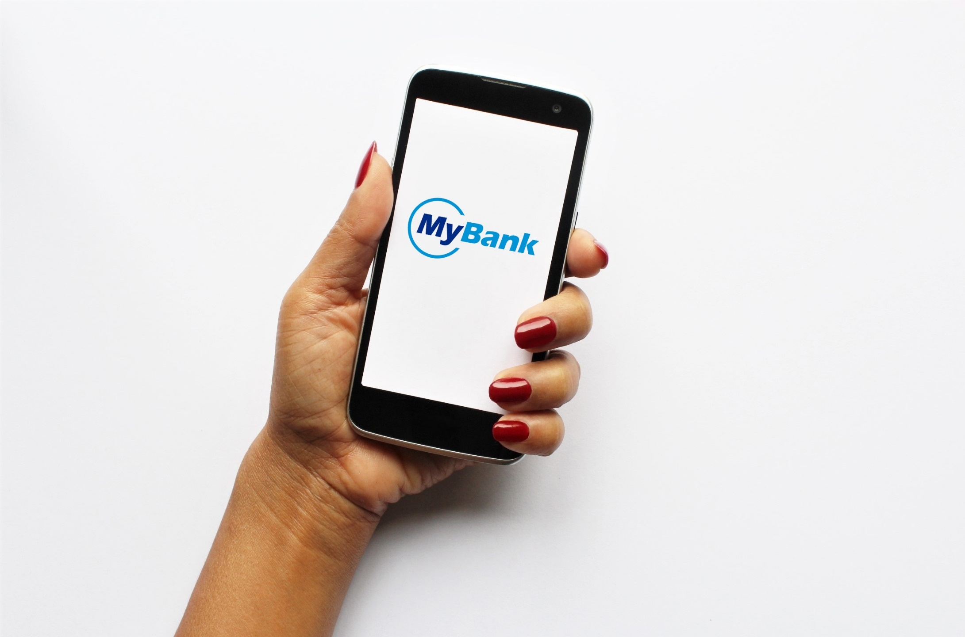

Hello Maya, what would you like to do today?
Or, it can be as easy as…
Username…
Password…
Number…
PIN…
Hello, good morning

Slide 3
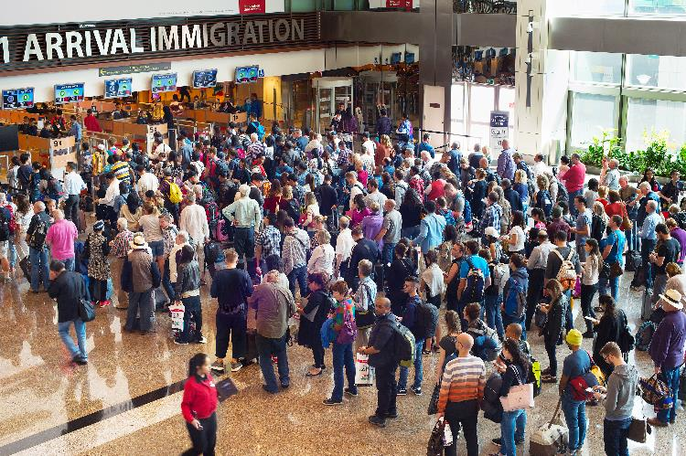
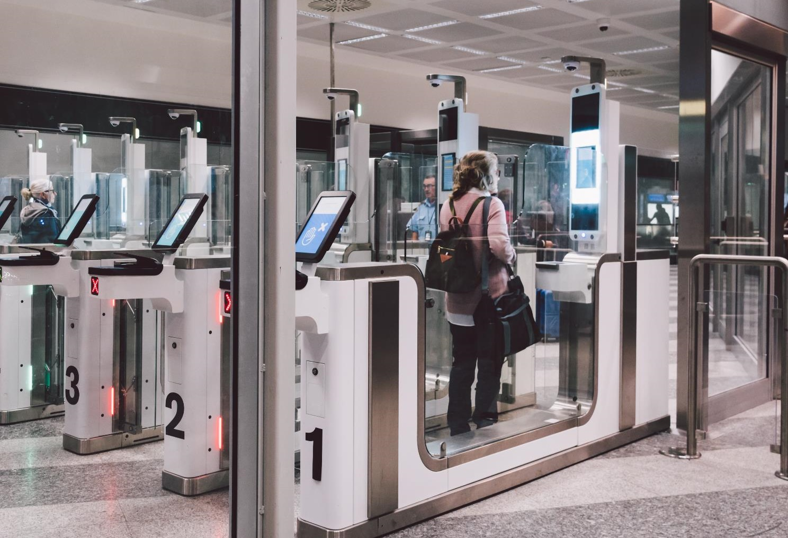
Welcome to Israel, Mrs. Cohen. Enjoy your stay.
Or, it can be as fast as…
Hello, it’s me…

Slide 4


Sorry Carol, you are too tired to drive now. Please rest or get some coffee.
Or, it could have been worse…
Please
start…

Slide 5
Who We Are
MBT is developing the most advanced voice-based biometric authentication technology
Combined with other techniques, we provide the strongest possible multifactor biometric protection and authentication
Our mission
Provide the ultimate protection for people, assets and data
Our vision
Become the leading global provider of multifactor biometric authentication solutions

Slide 6
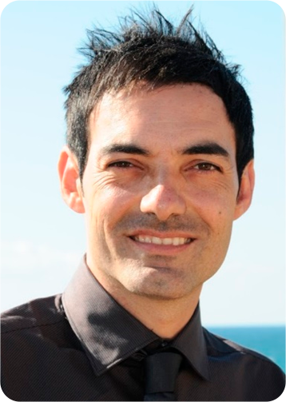
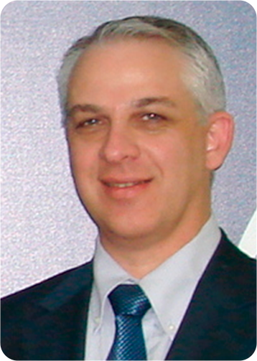
The Team
Eddi Nevoani
Founder & CEO
B.Sc. Computer Sciences (Haifa U.). Experienced in hi-tech management and software development. Fluent in various software tools and languages.
Ofer Atzmon
Business Development
B.Sc. electronics engineering (TAU). Highly experienced in international business development, marketing and sales of hi-tech solutions.

Slide 7
MBT – The X-Factor
Something you are
***
Something you know
Something you have
Something you feel
Somewhere you are

Slide 8
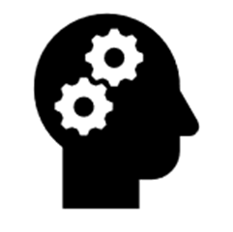


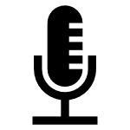

How it Works
Voice Analysis
Authentication
(1)
Pre-processing & S/N Enhancement
Feature Extractor
Template Generator
Competence
(2)
Authenticator
Personality
(3)
Stored Templates
Stage 1: Core Engine - Free-text speaker authentication
Stage 2: Behavioral layer 1 - User competence analysis and detection
Stage 3: Behavioral layer 2 - Personality analysis and detection

Slide 9
Main Advantages
Can’t be altered or copied
Doesn’t require any dedicated hardware or machines
Not intrusive and can be performed while engaged in other activities
Provides additional user information, such as emotion, mood, mental state
Can positively identify an individual within a crowd or noisy environment
Works over communication and phone lines
Can be embedded in any device, chip or cloud service
Natural and intuitive to use
Contactless
Very fast

Slide 10
The Market
Biometric systems touch every aspect of our life
They are used for secure personal identification, authentication and access to a variety systems, assets and applications
They affect a wide range of industries and vertical markets
The biometrics market is fast-growing, with voice biometrics being the fastest growing segment, due to increased demand in mobile apps and maturity of technologies ⁽¹⁾
(1) Source: 360iResearch, Nov. 2019

Slide 11

Use Cases – Vertical Markets
Service call centers
Finance & banking
(i.e. online/phone banking, ATMs, digital payments)
Ecommerce & online shopping
Access control
(i.e. corporations, airports, border crossings, public events)
Personal devices
(i.e. PC, tablet, smartphone, smart watches)
Government & law enforcement
Smart homes/IoT
Smart cars

Slide 12
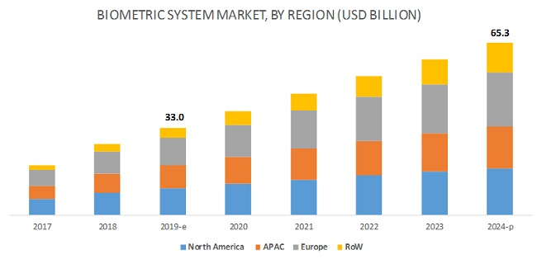
Market Size and Growth
Average annual growth rate (2019 – 2024): 14.6%
(1) Source: Markets and Markets, 2019

Slide 13





Competition & Positioning

Slide 14
Main Differentiation
Existing solutions are difficult to implement, have inconvenient user experience, and require special hardware, in addition to having serious limitations.
MBT is the only affordable, easy to implement, highly effective universal voice biometric solution that fits any digital or connected device or service.

Slide 15
Intellectual Property
Several patents are in process (awaiting funds)

Slide 16
Go to Market
MBT is a B2B company
We will provide cloud-based multifactor biometrics as a service (BaaS) to organizations
Sell/license an all-inclusive biometric code (API) to device manufacturers (i.e. mobile phones and IoT devices)
Sell/license to online service providers (i.e. banks and governments)
Initial focus: Smart mobility (driver fatigue alert,
anti-theft)

Slide 17
The Investment Opportunity
MBT is an early stage startup, built upon its team’s extensive experience, know-how and intellectual property
We are currently looking for seed investment of $1M.
Proceeds will be used for developing a working model,
proof-of-concept (POC) testing, MVP, certification,
standardization, and initial market penetration.

Slide 18

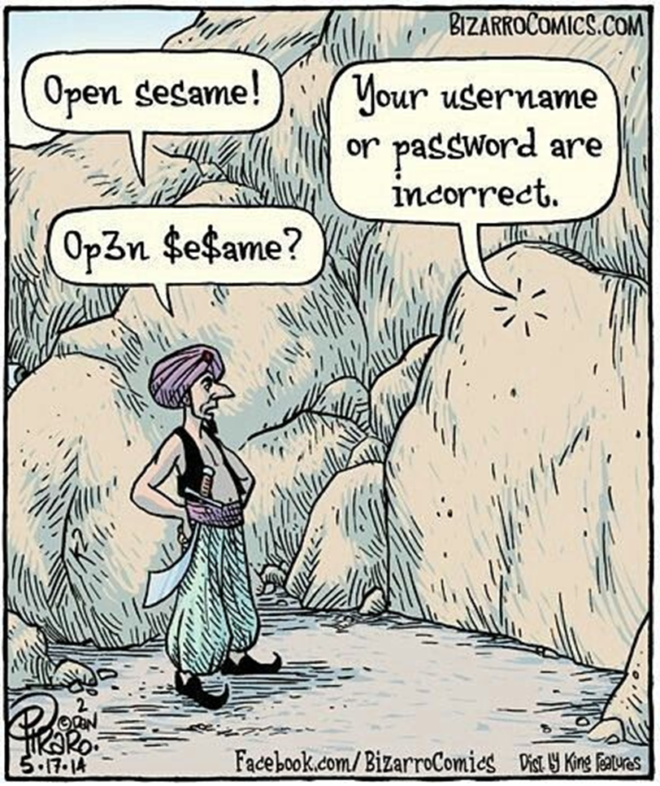
Thank you!
Eddi Nevoani
Founder & CEO
eddie@multibt.com
+972-52-3473028
Ofer Atzmon
Business Development
ofer@multibt.com
+972-52-2451771

